Slide 1

2509ICT Software Engineering
Modeling Language Part B -
Composition Trees and UML
Professor R.G. Dromey
Dr. Larry Wen
School of Information and Communication Technology
Lecture 4
© R.G.Dromey, Griffith University, 2007

Slide 2
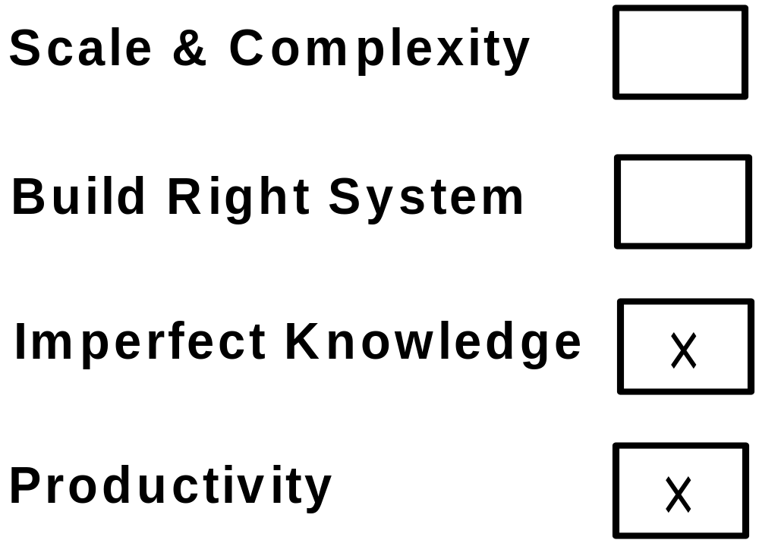
Where Are We Up To
✓
✓
Integrated View - Integrated Behavior Tree ✓

Slide 3
Behavior Engineering
Tackling
Imperfect Knowledge

Slide 4
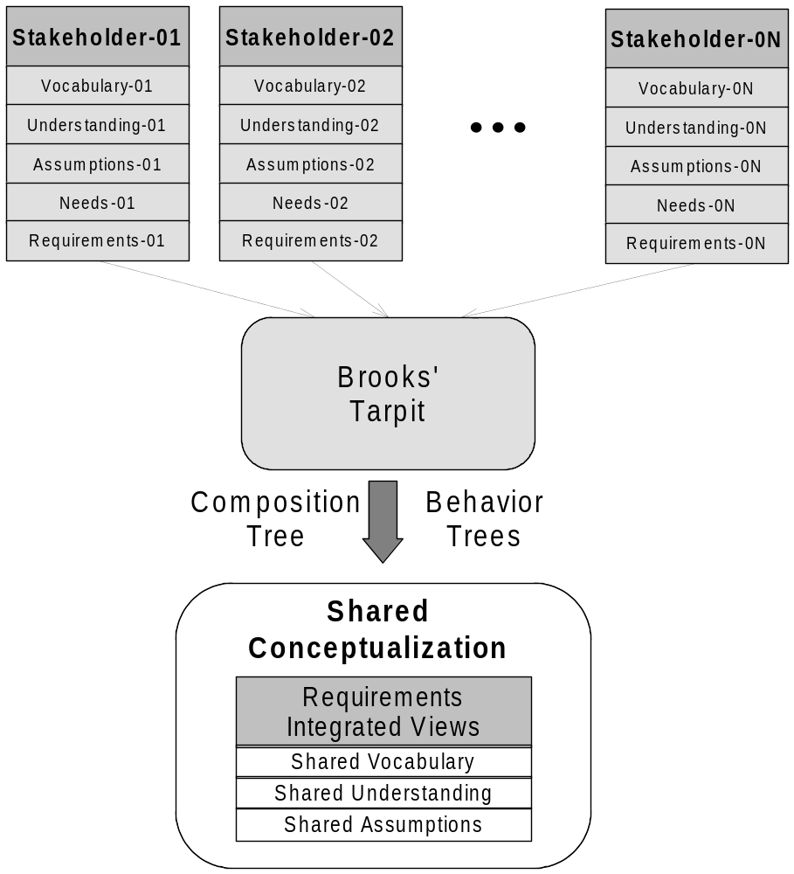
Problem 2 – Imperfect Knowledge
Inconsistencies among stakeholders

Slide 5
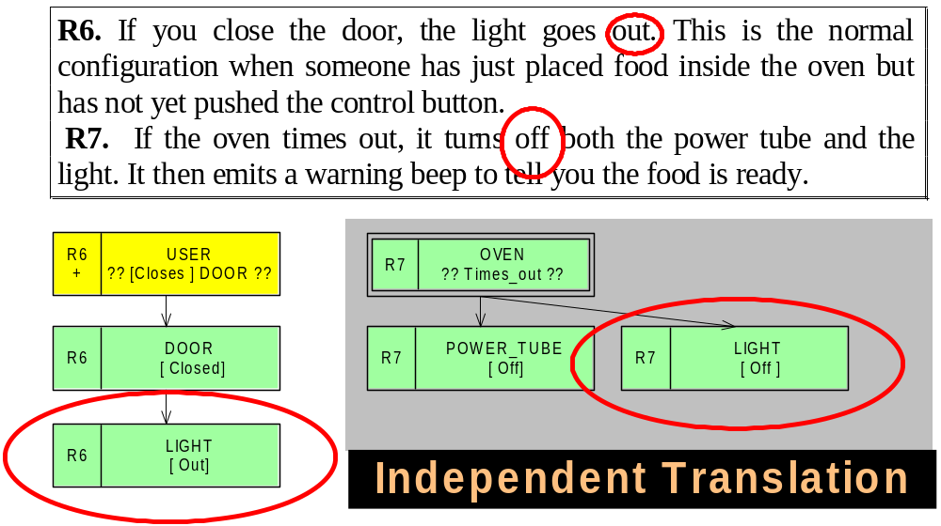
Imperfect Knowledge - Aliases
Inconsistency

Slide 6
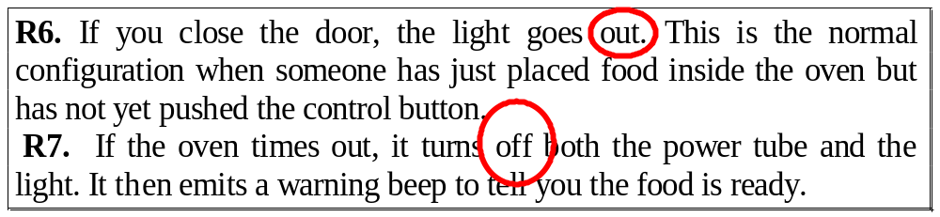
Imperfect Knowledge - Aliases
Implication
We could formalize each requirement
independently but we would end up
with an inconsistent vocabulary.
We have to overcome this problem.
Challenge when 100s requirements

Slide 7
Imperfect Knowledge - Aliases
We use a second
Integrated View
to solve problem
Integrated Composition Tree

Slide 8
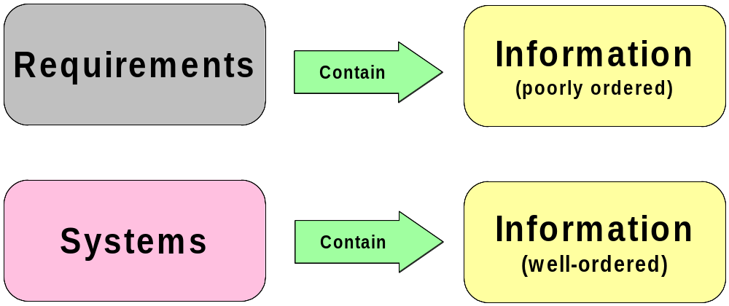
Requirements Versus Systems
Increase Order => Remove Imperfections

Slide 9
Where to Start => Understanding
Confronted with a statement of requirements our
job is to systematically and effectively increase our
understanding of the problem to be solved.
To increase understanding we need to create useful,
usable, new order in a repeatable, constructive way.
It turns out that constructing the system composition
is probably the most effective way to do this and
thereby initiate the analysis/design phase.
ROLE OF SYSTEM COMPOSITION

Slide 10
Composition
Composition is a concept that is
widely used in a number of
disciplines to provide useful
summary information about an
entity.
Useful summary information

Slide 11
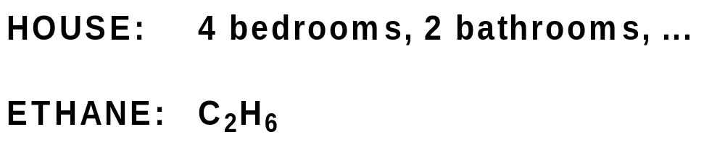

Composition
Examples
●
●
●
Relevant for analyzing/design of large systems

Slide 12
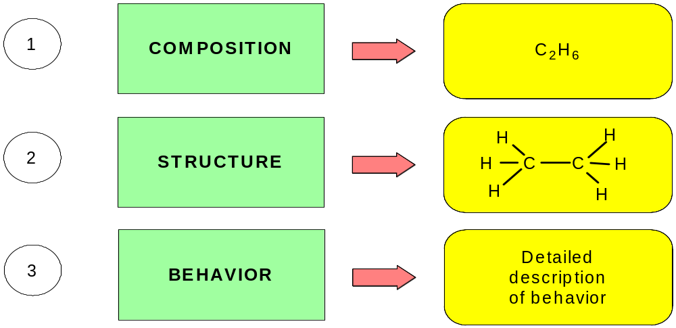
A Way to Look at Things - Chemistry
Representations
Ethane Molecule

Slide 13
What is Important About Composition
Composition is a fundamental property of a system.
Composition is a fundamental property of a set of functional requirements of a system.
Properties can be identified repeatably

Slide 14
What is Important About Composition
It should be UNIQUE
for a given statement
of requirements.

Slide 15
System Composition
The System Composition plays a role in system design of comparable importance to the role laying the foundations plays in constructing a house – it comes first and it supports all subsequent activities.
Complete Vocabulary ➔ Well-defined Property
System Composition => Built on System Vocabulary

Slide 16
What Composition Addresses
The problem we face in attempting to build an
understanding of the components in a system is
that in statements of requirements for a system,
information about an individual component in the system is usually widely spread throughout the set of requirements.
Component composition => System Composition

Slide 17
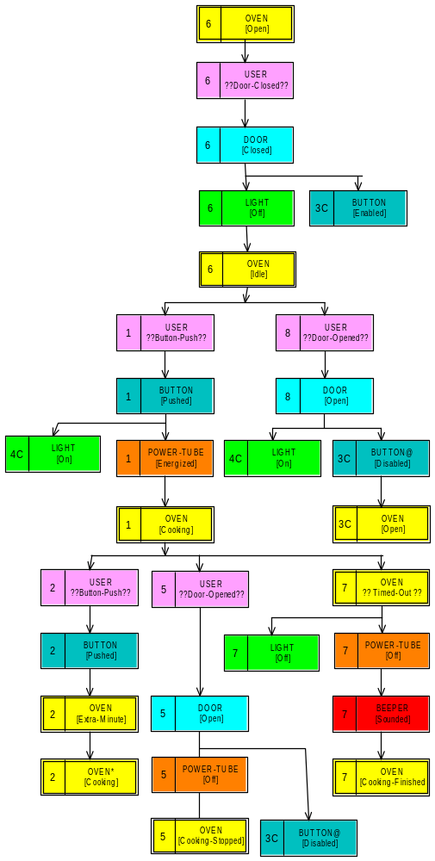
The Problem We Face
Integrated
Behavior Tree
R6
Result of integrating eight functional requirements
R8
= DOOR
DOOR Component
Mentioned in R6, R8, R5
R5
Individual Component Info dispersed across requirements

Slide 18

Creating an Integrated View
Information about “f” is spread across THREE pieces
Integrated View – Component “Picture” Emerges

Slide 19
Composition
Trees

Slide 20
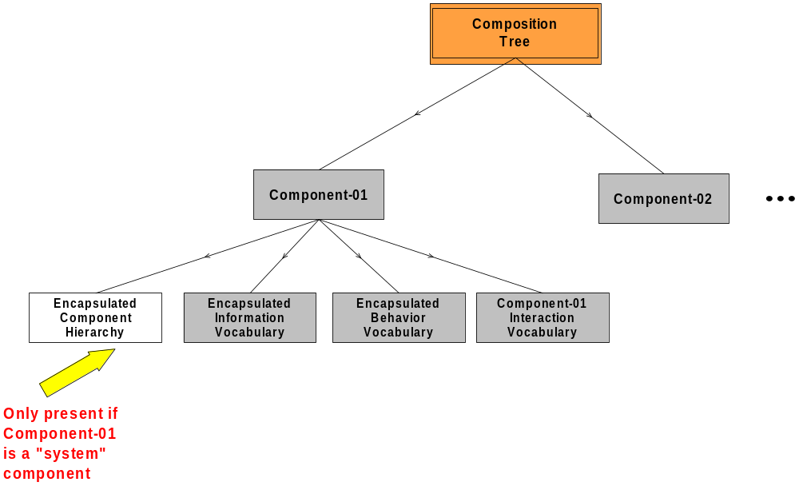
Composition Tree Form

Slide 21
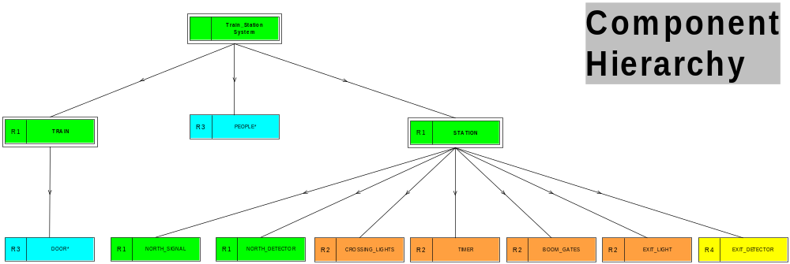
Composition Tree – Station System
System-of-Systems Integrated View

Slide 22
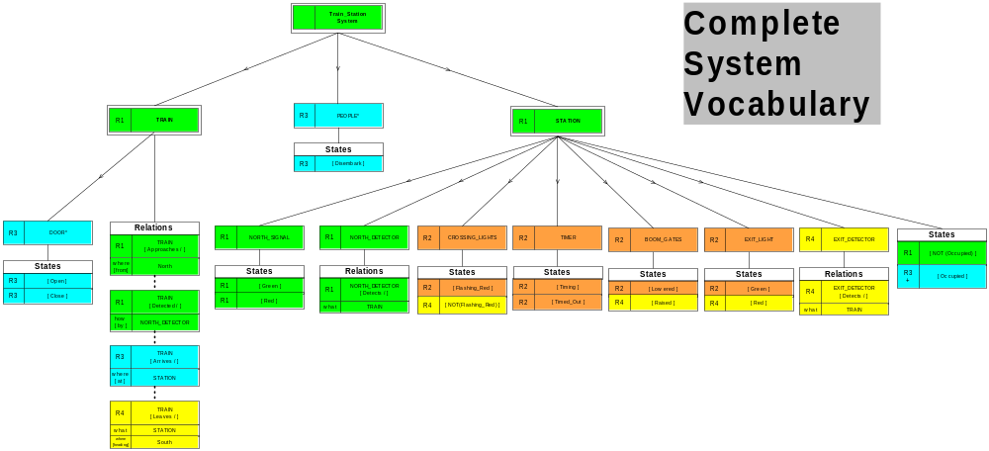
Composition Tree – Station System

Slide 23
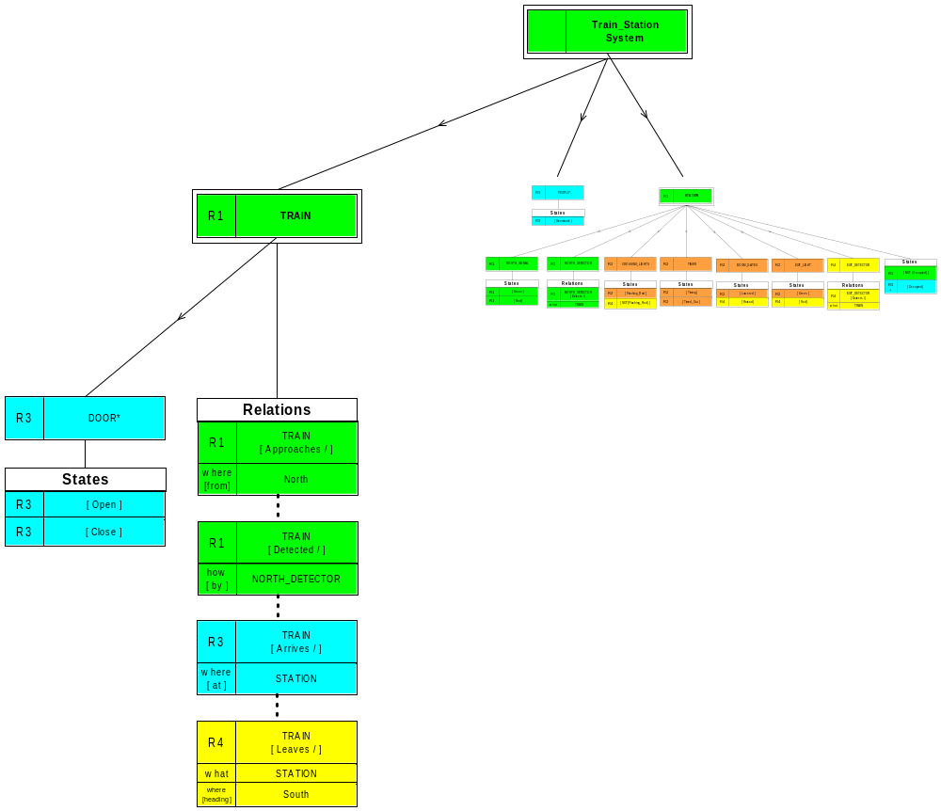
Composition Tree – Station System
Train
Station
All Information about a
single component is in
one place

Slide 24
Composition Trees
Provide an integrated view of data requirements
Provide integrated knowledge of each component
Provide a systematic way of finding many types of defects
Approach repeatability of construction
Provide information that supports subsequent steps
Provide an important perspective of the size/dimensionality
of the a large system
Provide vital information that supports understanding
and subsequent maintenance of the system
Provide information that can be easily and usefully
refined during later stages of development
Identify important system architecture information
Serve to construct the vocabulary of a system

Slide 25

Earlier We Saw

Slide 26

Now We Want to Consider

Slide 27
Composition Tree
Requirements Translation
+
Integration
Process for Construction

Slide 28
Creating
an Integrated
Compositonal View
From
Requirements

Slide 29
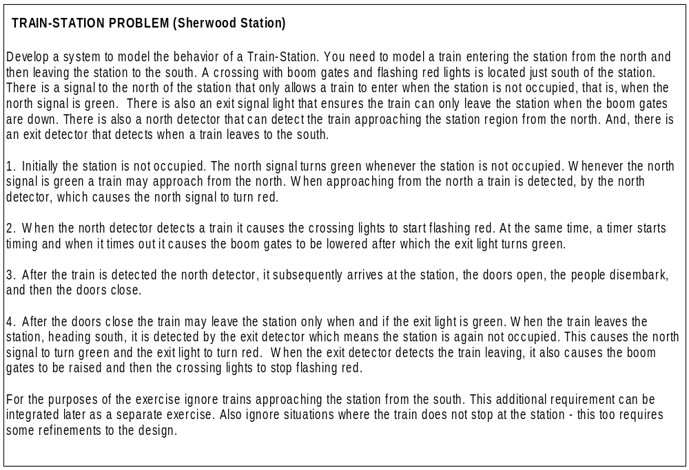
Example – Train Station System

Slide 30
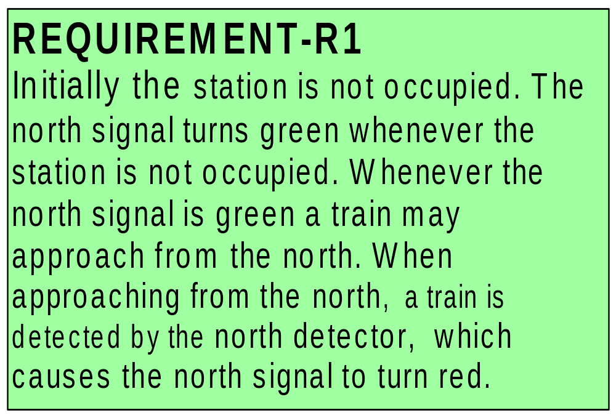
Composition Tree
Requirements Translation

Slide 31
R1
Initially the station is not occupied.
The north signal turns green whenever the station is not occupied.
Whenever the north signal is green a train may approach from the north.
When approaching from the north, a train is detected by the north detector, which causes the north signal to turn red.

Slide 32
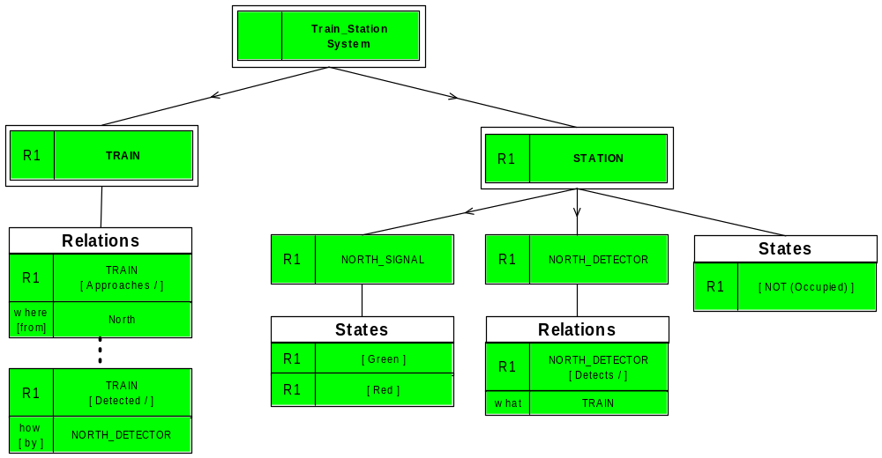
Composition Tree – R1
Requirements Translation - One at a time

Slide 33
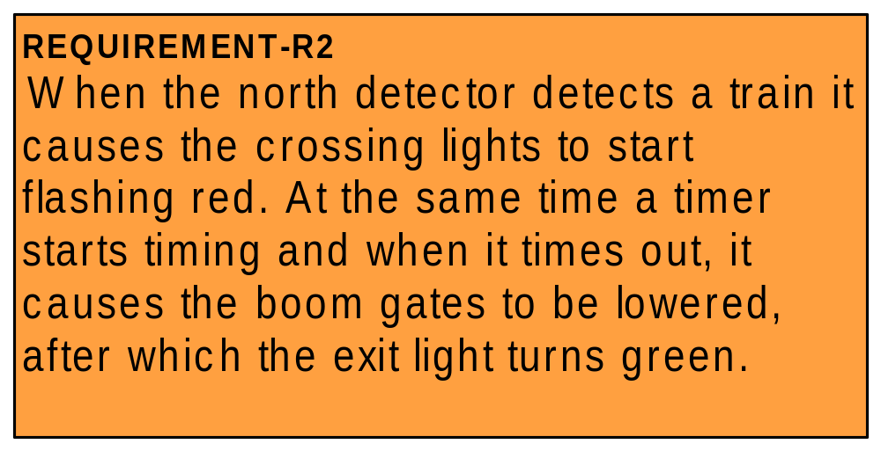
Composition Tree – Integrating R2
Requirements Translation PLUS Integration

Slide 34
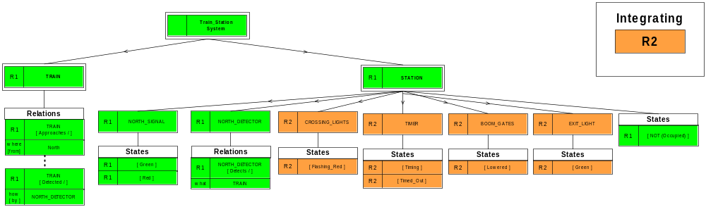
Composition Tree – Integrating R2
Requirements Translation PLUS Integration

Slide 35
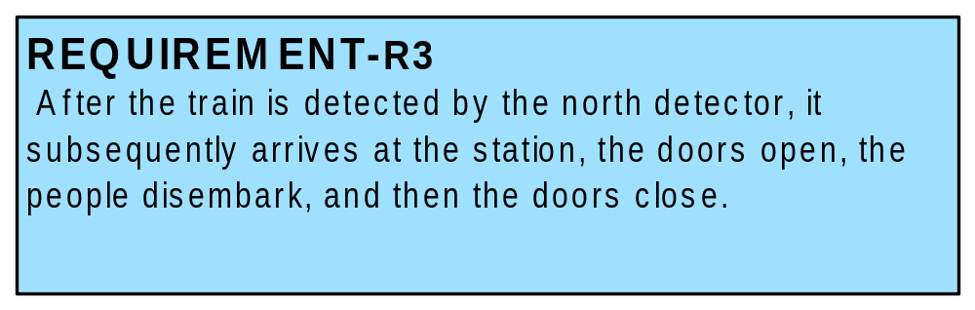
Composition Tree – Integrating R3
Requirements Translation PLUS Integration

Slide 36
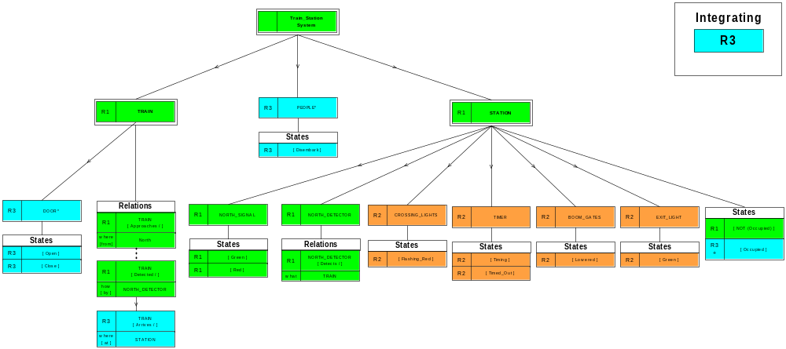
Composition Tree – Integrating R3
Requirements Translation PLUS Integration

Slide 37
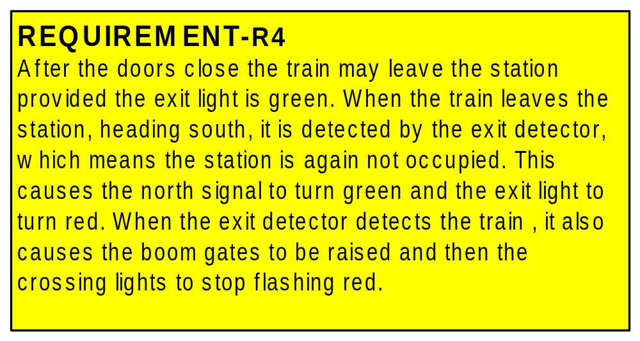
Composition Tree – Integrating R4
Requirements Translation PLUS Integration

Slide 38
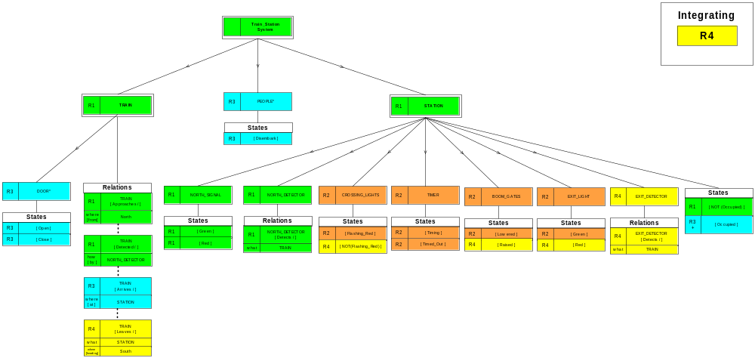
Composition Tree – Integrating R4
Requirements Translation PLUS Integration

Slide 39
Translation to Composition Tree
TWO
Integrated Views

Slide 40
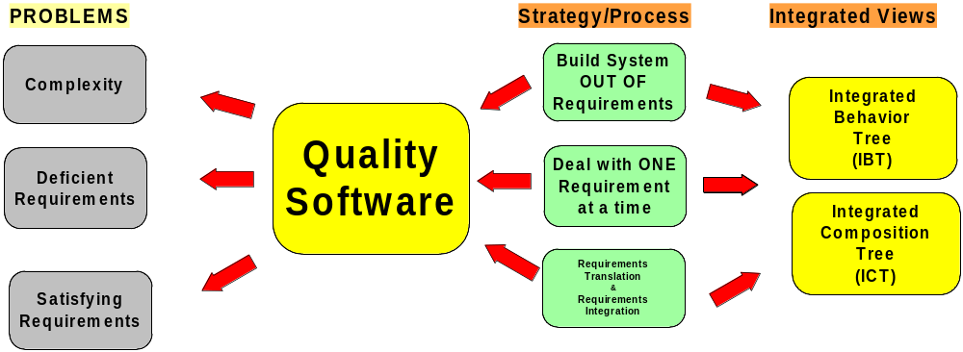
Two Integrated Views
Tackling Software Engineering’s Problems Head-on
Tackling Software Engineering’s Problems Head-on

Slide 41
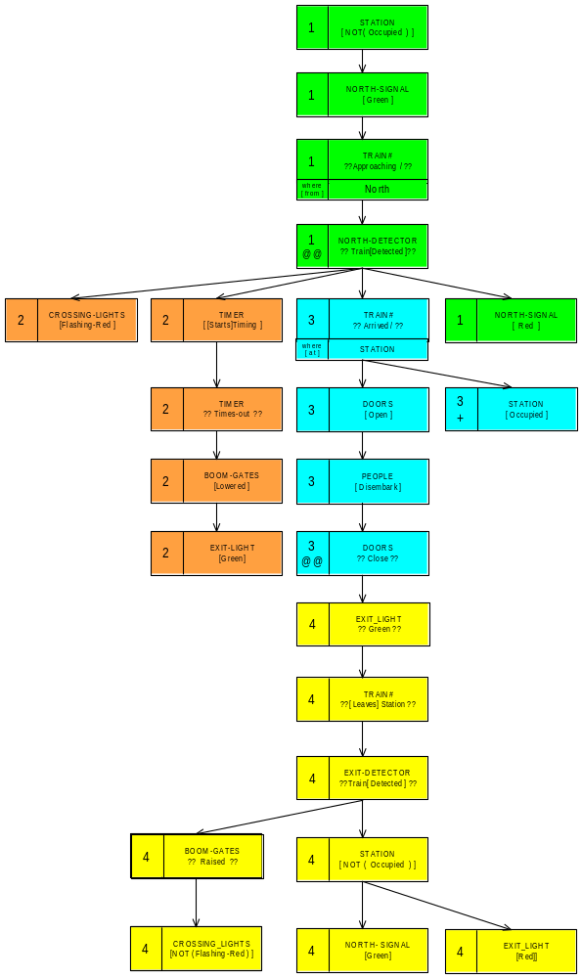
Integrated Behavior Tree - IBT
Benefits of Behavior Integration
See system behavior as a whole
Integration - detects requirements defects
Can refine => Specification => Design
Model-checking, simulation, code-gen.
Aids component design & implementation
First Integrated View

Slide 42
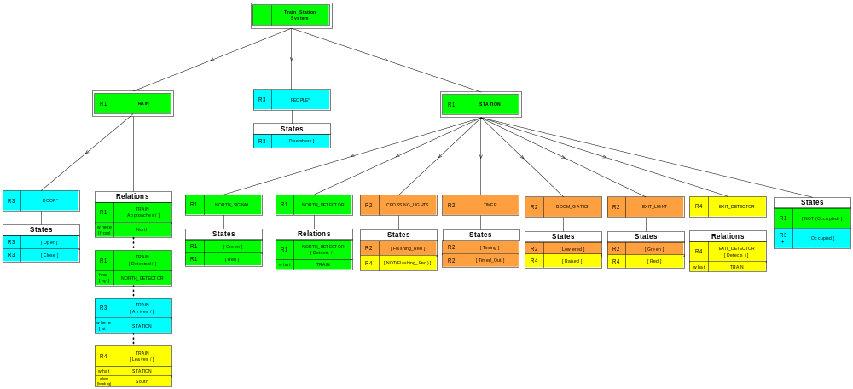
Integrated Composition Tree - ICT
Benefits of Composition Integration
All information about a component - is in ONE place
Aids component design and implementation
Integration - Helps detect inconsistent information
Provides complete system vocabulary – all in context
Second Integrated View

Slide 43
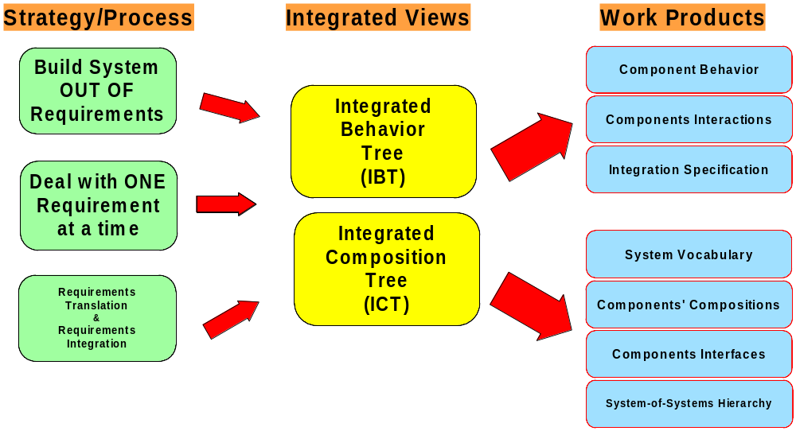
Where We Are Up To
✓
✓
Two Integrated Views ✓

Slide 44
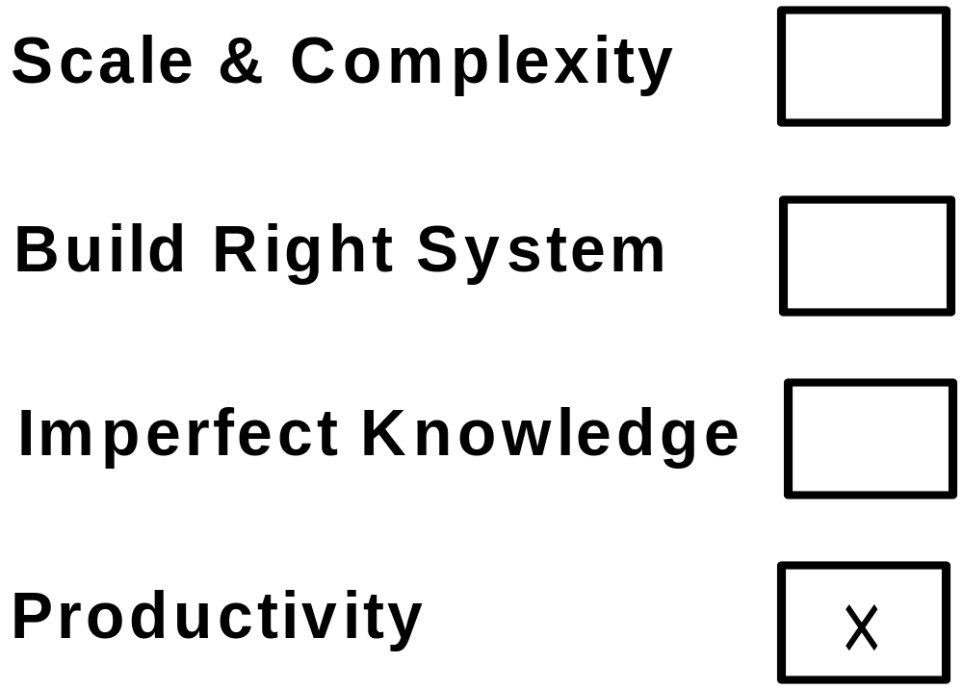
Where Are We Up To
✓
✓
✓
Integrated Views of Behavior & Composition

Slide 45
Behavior Engineering
Tackling
Team Productivity

Slide 46
Collaborative Editing
Development
By
Teams
Integrated Composition Tree + BTs in Parallel

Slide 47
Collaborative Editing - Advantages
Team members translate subsets of requirements.
Integrated Composition Tree provides strict
progressive vocabulary consistency.
Each team member sees dynamically how the
work of others affects their work.
Practical, transparent way to combine the work
of individual team members.
Reduces project team communication overhead.
Potential for significant productivity gains

Slide 48
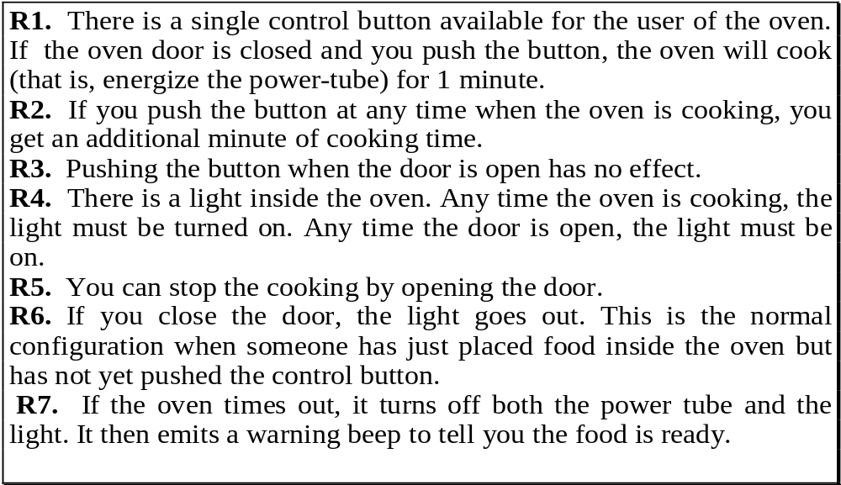
Collaborative Editing
Microwave Oven – Functional Requirements
Finding
Alias Defects
After Shlaer and Mellor, Object Life Cycles, p.36
Requirements Translation

Slide 49
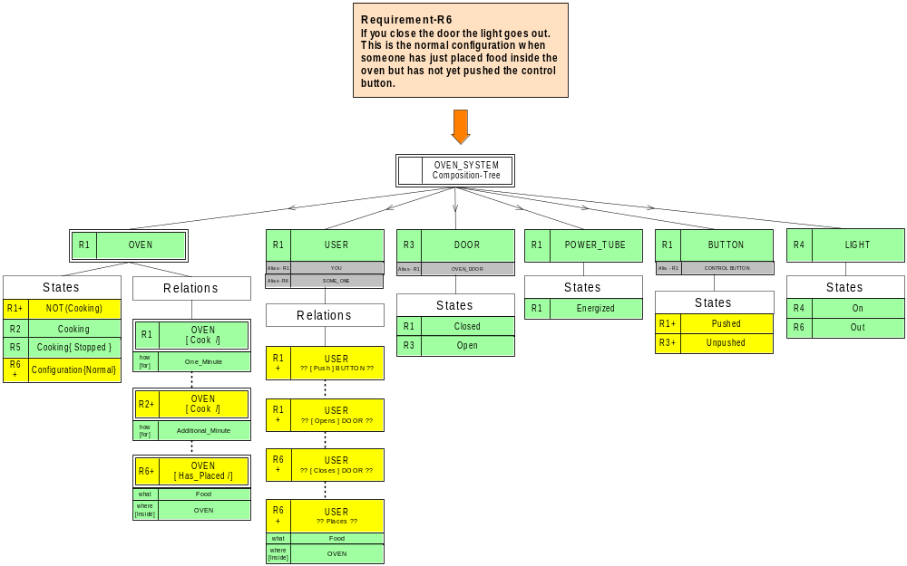
Collaborative Editing - ICT
Finding
Alias Defects
Composition
Tree
Finding
Alias Defects
Requirements Translation – R6

Slide 50
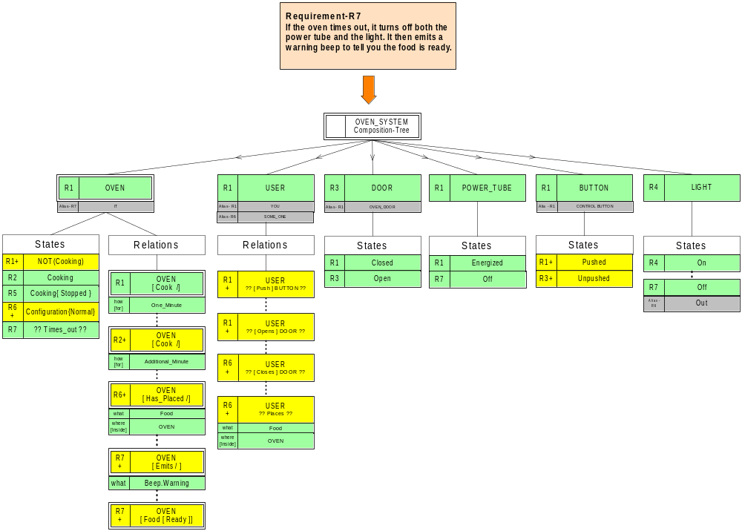
Collaborative Editing - ICT
Finding
Alias Defects
Composition
Tree
Finding
Alias Defects
Finding alias defects

Slide 51
Behavior Engineering
Work
With Industry

Slide 52
Work With Industry
Behavior Engineering trials on a series of
large projects with one large company
consistently found 10 – 15%
of requirements analyzed contained
significant defects not found by their
review processes.
Company is a CMMi company with mature
processes.
Similar statistics on projects for other large
companies and organizations

Slide 53
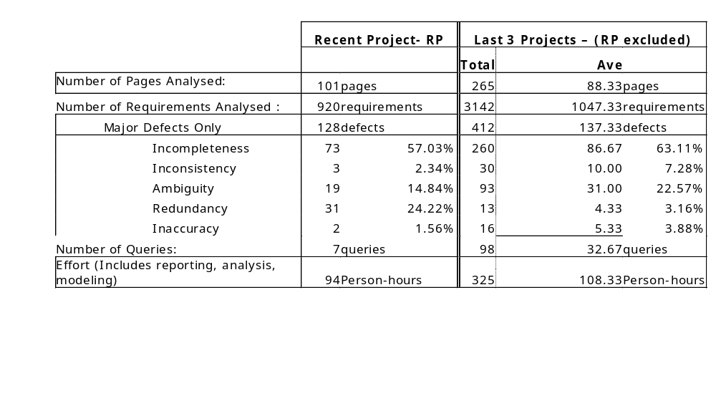
Work With Industry
The following table contains statistics on recent projects where we have applied the method.
What the results show is that the Behavior Engineering method consistently finds
130 major defects per 1000 of requirements after normal reviews and correction have
been carried out. In addition the integrated work products constructed to detect defects
can subsequently be corrected and refined to create an executable design.

Slide 54
Translation to Composition Tree
… and more information
www.beworld.org

Slide 55
Unified Modeling Language (UML)
UML is the successor to OOA&D (object-oriented analysis and design methods) that appeared in the late 1980s and early 1990s.
UML is an OMG (Object Management Group) standard.
UML is associated with RUP (Rational Unified Process), but you can use UML with following the process.
The first mature version is UML 1.1 and the latest version is UML 2.x

Slide 56
UML Diagrams
UML 2.0 includes 13 different types of diagrams. Those diagrams can be grouped in three categories.
Structure diagrams
Behavior diagrams
Interaction diagrams

Slide 57
UML Structure Diagrams
Structure diagrams model the structure or composition of the system. They include:
  Class diagram: describe the structure and relationships among classes.
  Component diagram: show the relationships between components
  Composite structure diagram: shows the internal structure of a class
  Deployment diagram: models the hardware, the environment and the artifacts deployed on the hardware
  Object diagram: models the runtime structure
  Package diagram: split the system into a few logical group and model the relationship between the groups.

Slide 58
UML Behavior Diagrams
Behavior diagrams model what must (might) happen in a system. They include:
  Use case diagram: shows the functionality provided by the system in term of actors (external systems or users) and their goals, which are represented as use cases; and the dependency among those use cases.
  State machine diagram: similar to the state diagram used by many other process.
  Active diagram: models high level workflow of the system.

Slide 59
UML Interaction Diagrams
Interaction diagrams is a subset of behavior diagram. They emphasize the flow of control and data among the things being modeled. They include:
  Sequence diagram: show how objects communicate with each other in term of messages
  Communication diagram: it models a mixture of static structure and dynamic behavior of the system
  Interaction overview diagram: it is a type of activity diagram with the nodes are interaction diagrams
  Timing diagrams model the time constrains

Slide 60
In this course
We will brief introduce three most commonly used UML diagrams: use case diagram, class diagram and sequence diagram.
Other reference:
  Fowler, M., Scott, K., 2000, “UML Distilled A Brief Guide to the Standard Object Modeling Language”, ISBN: 020165783X, Addison-Wesley Publishers Ltd., 2000. (only cover UML 1.3)
  http://www.uml.org/ (latest UML information)

Slide 61

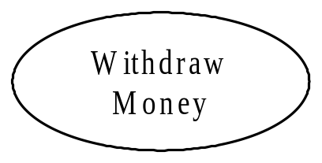
Use Case Diagram
Actor: an actor is a role that a user ( or may be an external system) plays with respect with the system. It is usually represented by a symbol of a small man like this.
Use case: a use case is a high level function provided by this system. It is represented by an oval.

Slide 62
Use Cases Scenario Questions
  Who is the actor?
  What are the actor’s goals?
  What main tasks or functions are performed by the actor?
  What extensions might be considered as the story is described?
  What variations in the actor’s interaction are possible?
  What system information will the actor acquire, produce, or change?
  Will the actor have to inform the system about changes in the external environment?
  What information does the actor desire from the system?
  Does the actor wish to be informed about unexpected changes?

Slide 63
A Use Case Diagram Example
Suppose that there is an ATM system. A customer can use this system to check his bank account balance and withdraw money. Of course, the ATM need to be connected with a bank system and it can retrieve the customer’s bank information from the bank.
This system includes two actors (customer and bank system) and three use cases: check account balance, withdraw money and retrieve account information.

Slide 64
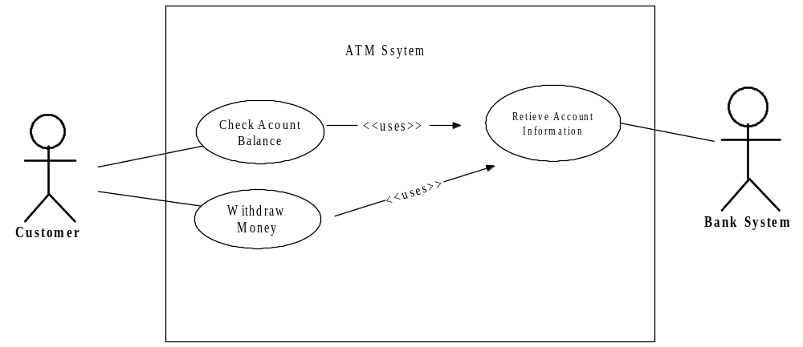
The Use Case Diagram Example

Slide 65
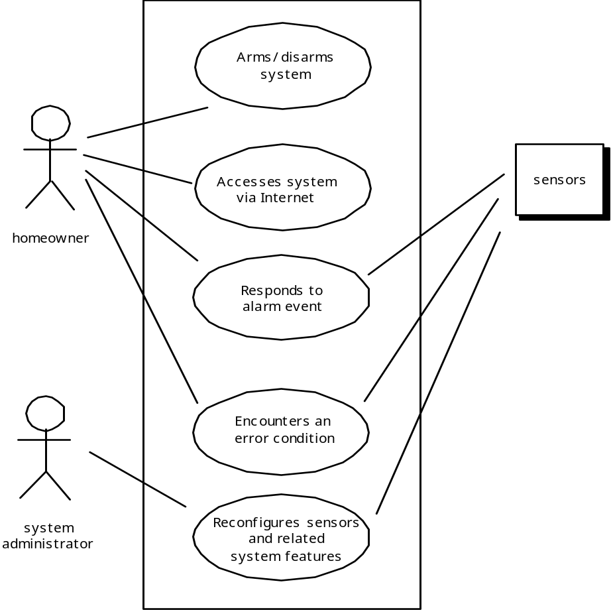
More Examples

Slide 66
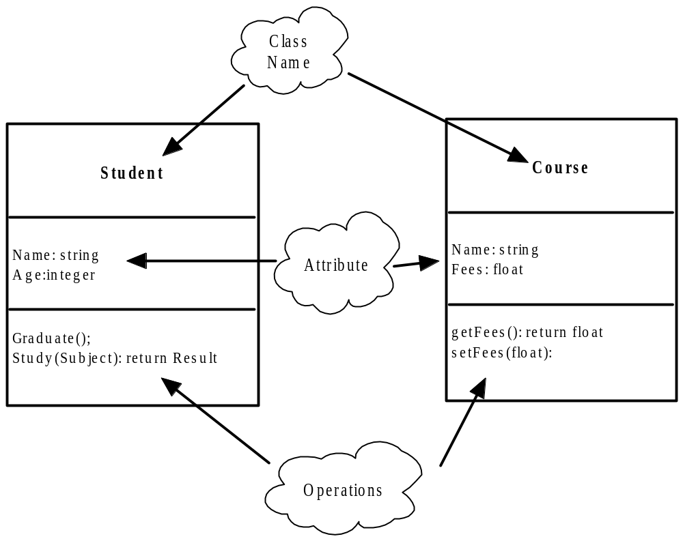
Class Diagram – 2 Classes

Slide 67
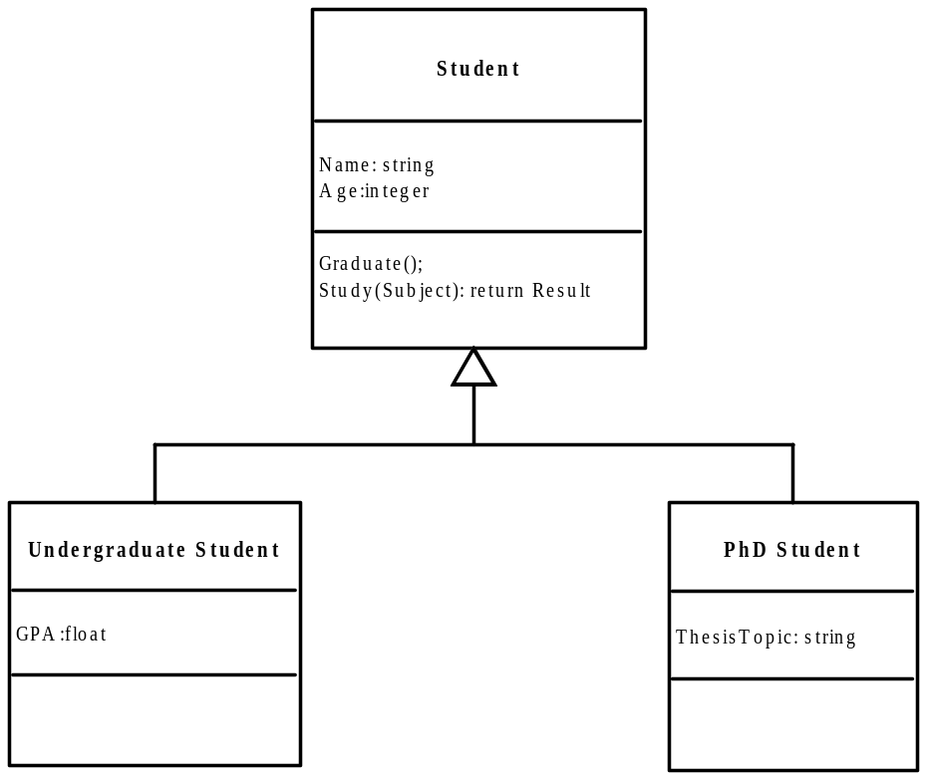
Class Diagram – Generalization (Child Classes)

Slide 68
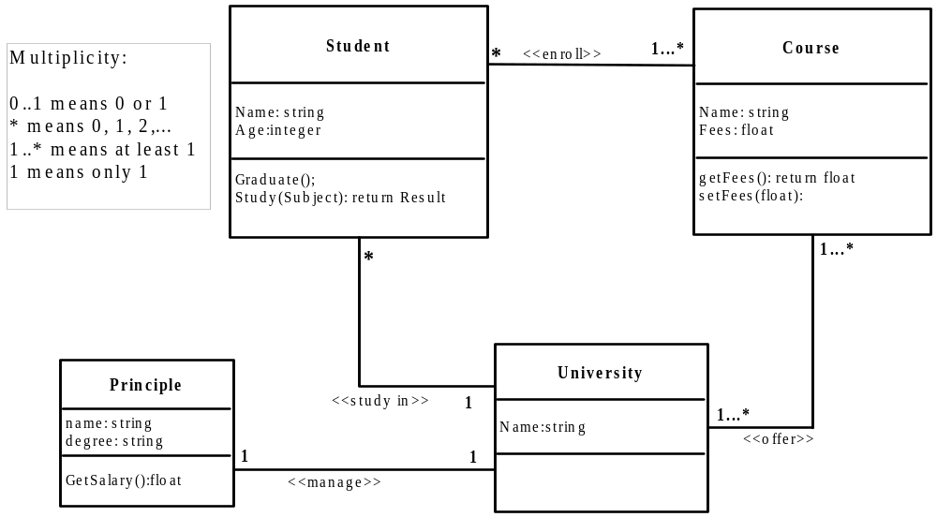
Class Diagram – Association

Slide 69
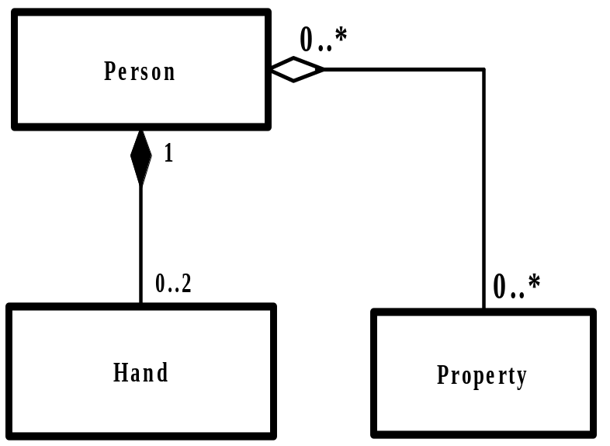
Class Diagram – Aggregation and Composition
Both aggregation and composition indicate a relationship of “has a”, but composition is stronger.

Slide 70
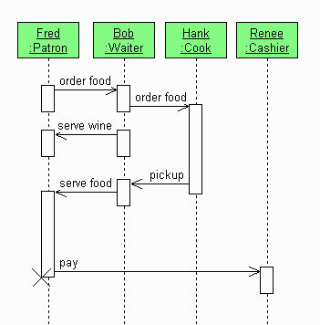
Sequence Diagram
A sequence diagram is a kind of interaction diagram that shows how processes operate with one another and in what order. It is a construct of a Message Sequence Chart.
An object is shown as a box at the top.
The vertical line under an object is called the objects lifeline.
Within the rectangle bar, the associated object is active; in the dotted line, the associated object is inactive.
In this diagram, Fred is an object (instance) of class Patron.

Slide 71
Limitation with UML
UML is good to model part or a system, or a very high level of a system, but it is difficult to present the whole system in one integrated view.
It is difficult to check the consistency among different UML diagrams
There is no formal method to integrate two UML diagrams into one diagram.

Slide 72
Summary
What kind of defects may user requirements usually have?
List the three most common representations of a system.
Why composition is important?
To be familiar with composition tree notations.
Be able to translate user requirement into composition tree and integrate into an integrated composition tree (ICT)
Why composition trees are important?
What are benefits of composition integration?
What are UML diagrams and what are they used for?
Be able to draw simple use case diagrams, class diagrams and sequence diagrams?
What are the limitations of UML diagrams?

